Slide 1

CargoSync — Intelligent freight & fleet orchestration
Cloud platform that connects shippers with available trucks, automates load planning, and verifies chain-of-custody from pickup to confirmed delivery. Designed for logistics managers, operations leaders and technical product stakeholders.

Slide 2
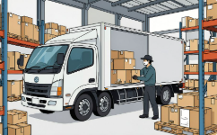

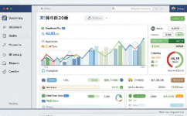
Why CargoSync
Reduce empty space
Eliminate manual errors
Improve visibility
Live GPS, ETA updates and immutable audit logs reduce disputes and speed payouts.
3D bin-packing maximises cubic utilisation so fewer trucks carry the same freight.
QR-based scanning validates manifests at load, in-transit and delivery stages.

Slide 3
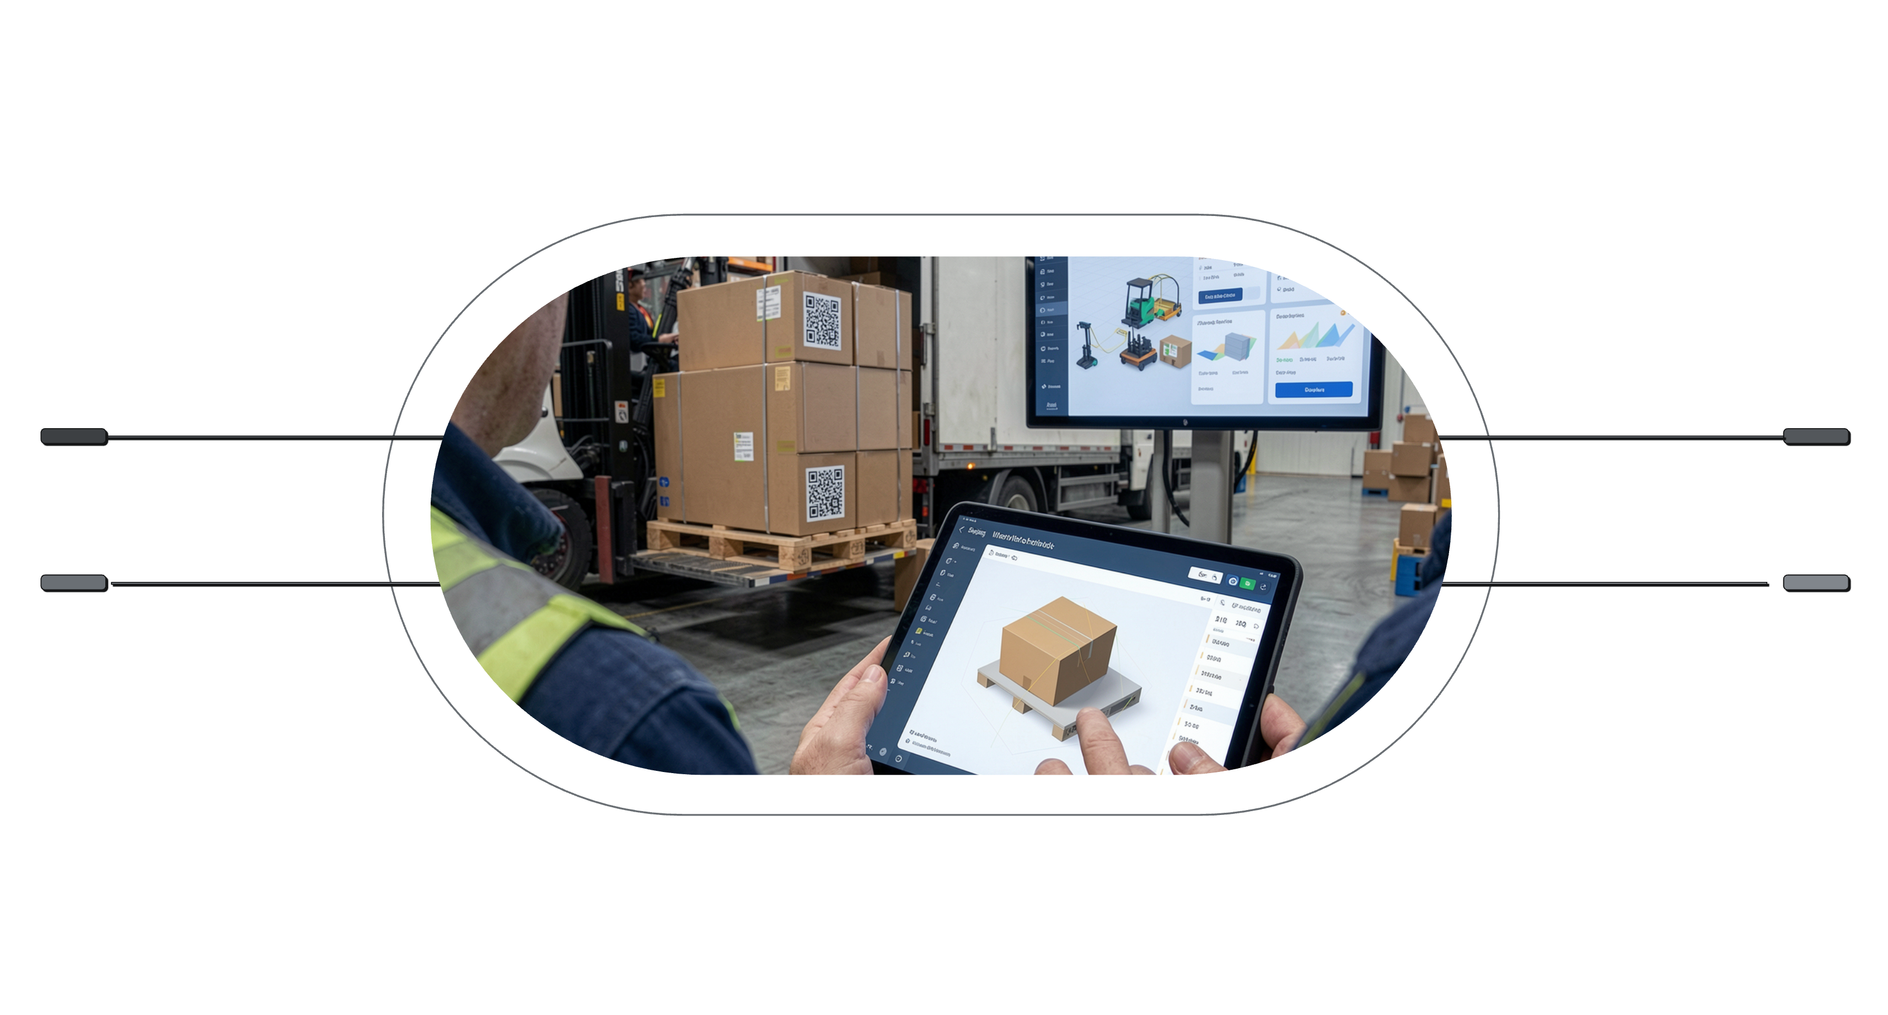
How it works — end to end
Job Creation
Optimization
Enter shipment and box-level details
3D bin-packing and reverse sequencing
Loading Scans
Delivery & Payout
QR scans and optional door sensors
Confirm delivery and release escrow
The platform moves from job entry to automated optimisation, validated physical handling, and conditional payment release — creating a single, auditable workflow for every shipment.

Slide 4






Core modules
Authentication & Accounts
Truck & Fleet Management
Multi-tenant company accounts, role-based permissions, billing integration.
Define interior dimensions, max load, drivers, schedules and availability.
Booking
Optimization Engine
Post jobs, preview capacity-fit for nearby trucks, or assign owned assets.
3D bin-packing for space efficiency; reverse sequencing to prevent rehandling.
Scanning & Chain-of-Custody
Live Tracking & Payments
Per-box QR codes, real-time manifest validation, tamper flagging, photo signatures.
GPS ETAs, escrow-style payouts tied to delivery scans and automated invoicing.

Slide 5
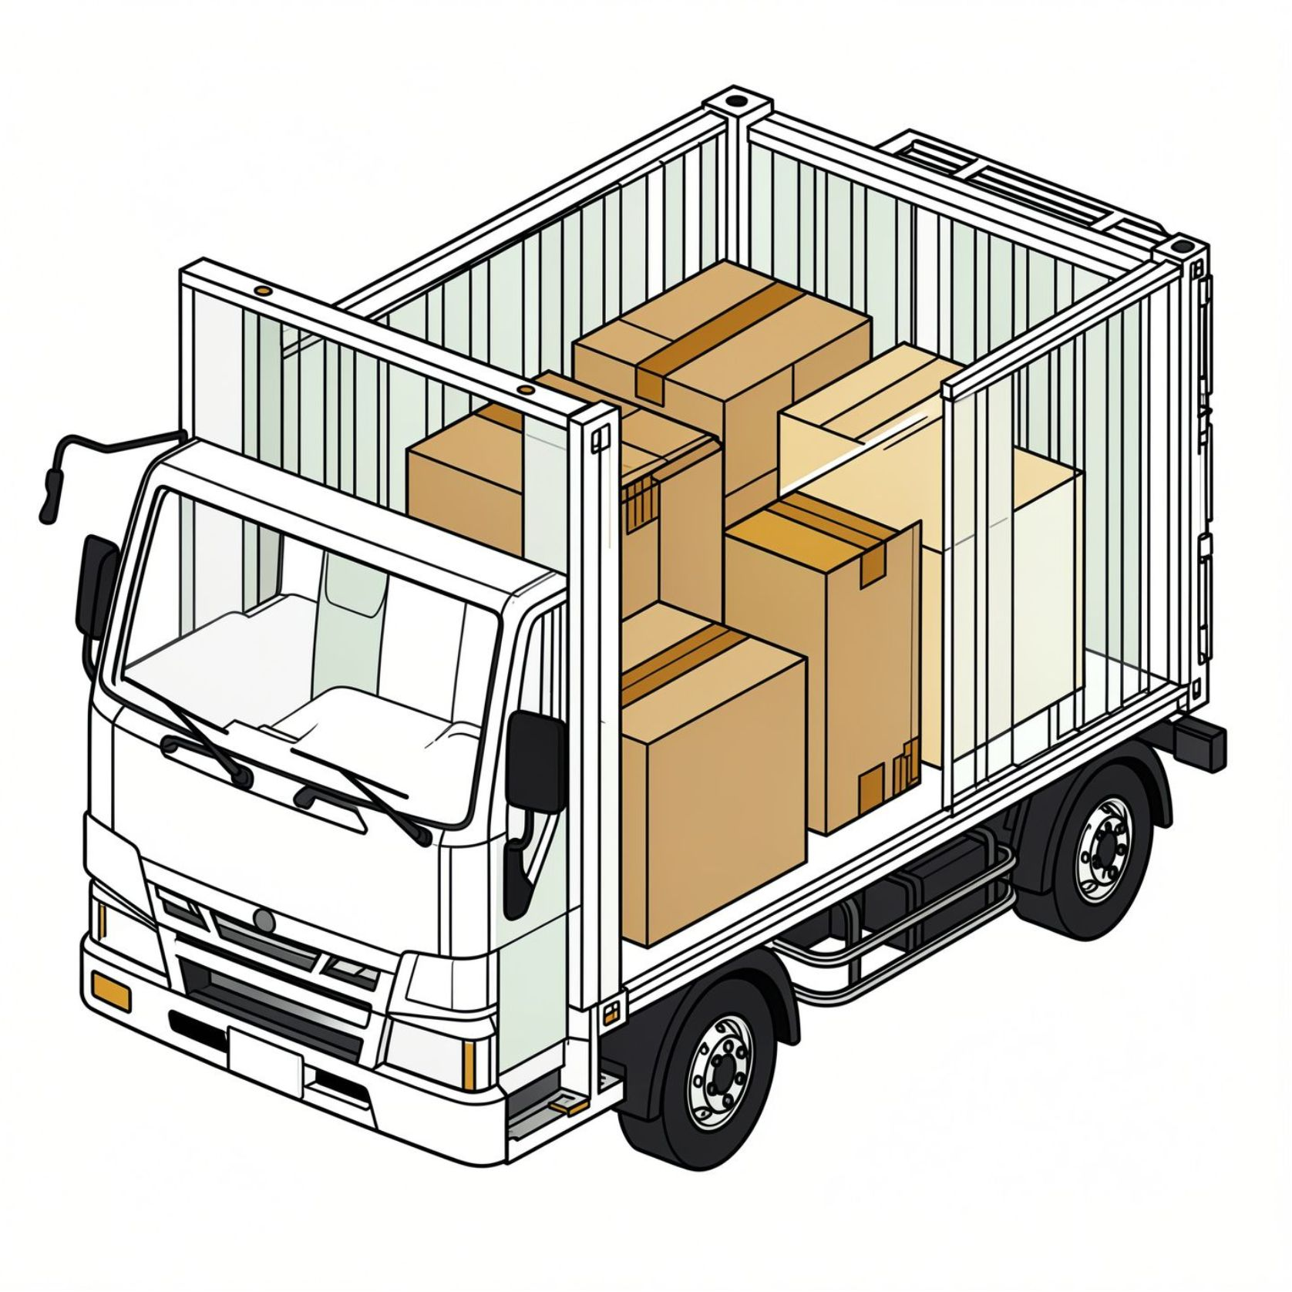
Optimization details
3D bin-packing
Computes an orientation-aware arrangement of individual boxes inside a truck volume to maximise utilisation while respecting weight distribution and fragile flags.
Reverse sequencing
Produces a loading order where last-stop boxes are placed for immediate access, preventing mid-route rehandling and saving driver time at stops.

Slide 6
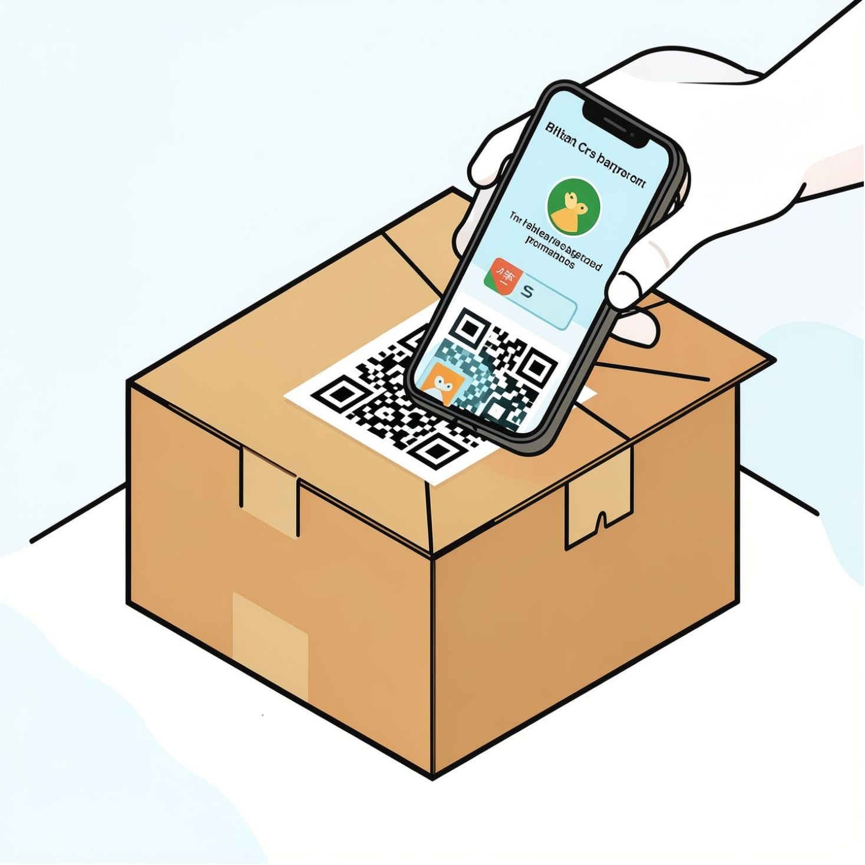
Scanning & chain-of-custody
Every box receives a unique QR at job creation. Scans occur at:
Loading — validates against digital manifest in real time
In transit — optional door-sensor and tamper detection alerts
Delivery — recipient confirmation with digital signature and photo
Result: immutable, timestamped audit trail for dispute resolution, insurance claims and automated payment release.

Slide 7
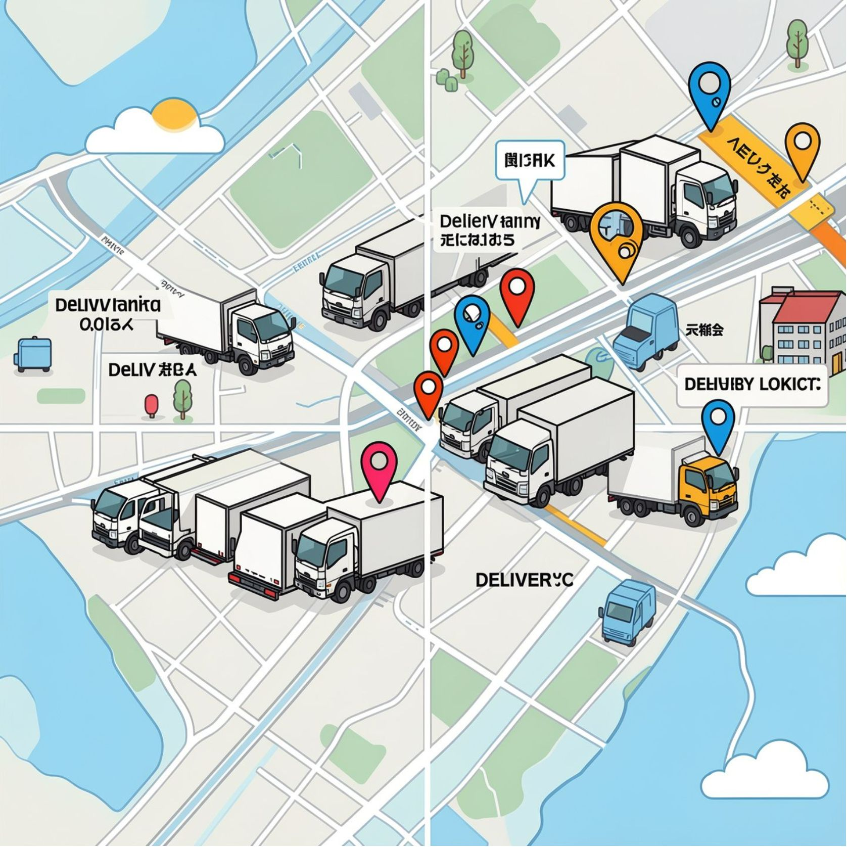
Marketplace & matching
For non-owned fleets, CargoSync surfaces nearby trucks based on:
Real-time GPS proximity
Capacity and dimensional fit
Trucker rating and verification status
Truckers receive a load preview (volume, weight, route, payout, handling flags) and accept offers; scoring balances efficiency with fairness.

Slide 8

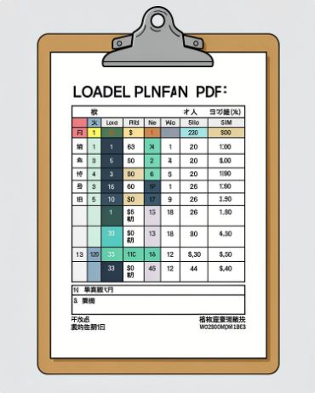
Operations & driver experience
Driver app
Exportable outputs
Step-by-step loading map, scan history, route sheet and proof-of-delivery capture.
Visual load maps, PDF route sheets and manifests for easy compliance and handover.

Slide 9
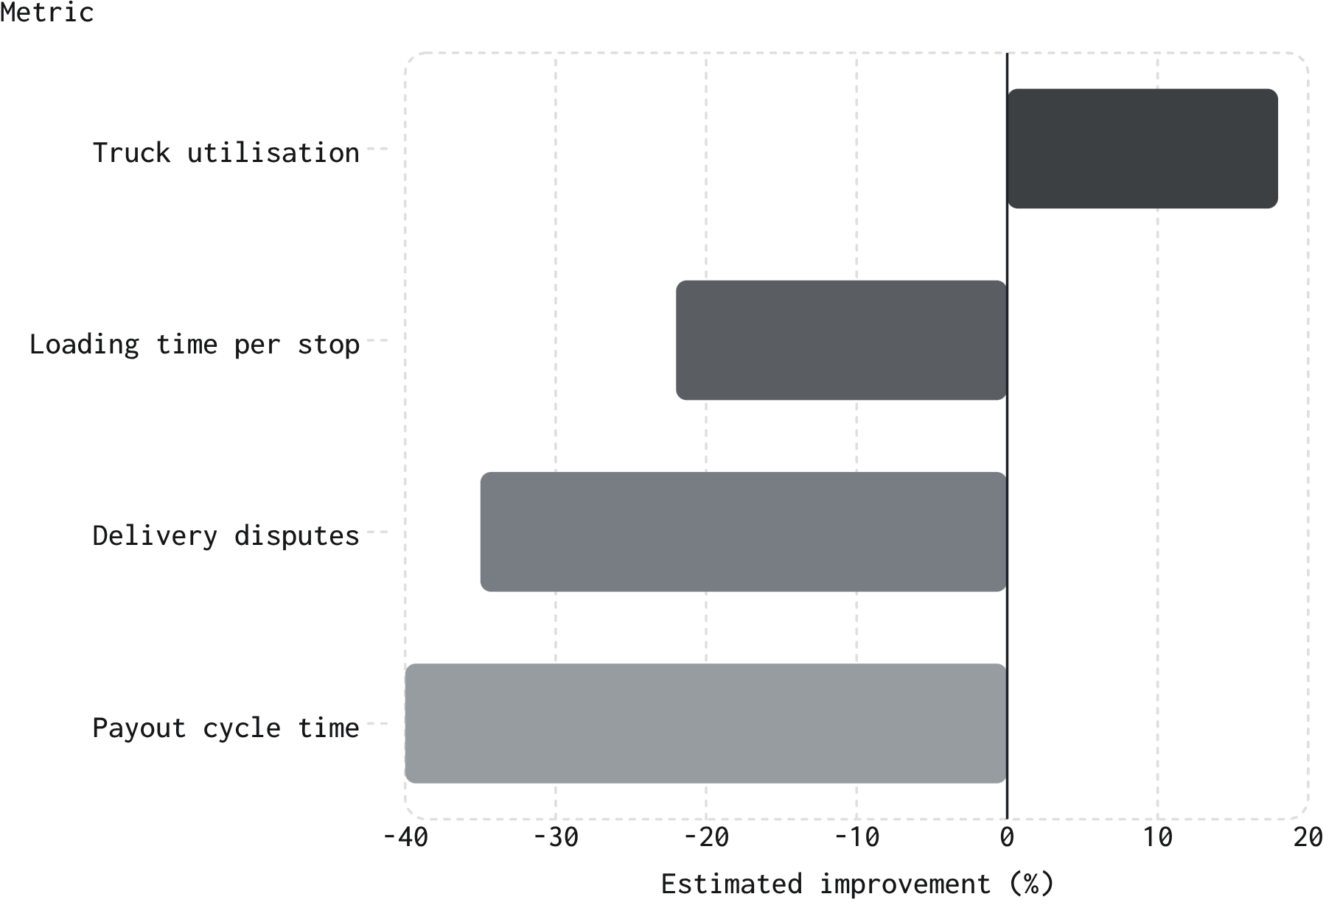

Analytics & business impact
Dashboard metrics include capacity utilisation, on-time delivery rate, dispute volumes and cost-saving projections. Data exports support finance, ops and carrier performance reviews.
These KPI improvements reflect typical outcomes from optimised packing, sequencing and verified delivery flows.

Slide 10

Next steps & rollout
01
02
Phase 1 — Pilot
Phase 2 — Scale
Onboard pilot shippers and 10–20 trucks; validate optimisation and scanning in live routes.
Integrate with TMS/WMS, expand marketplace, enable billing and escrow workflows.
03
Phase 3 — Optimise
Refine matching score, introduce predictive ETAs and advanced analytics for continuous gains.
Project leads: Farhad Shihab Yaseen, Dharvesh Ahamed. For a technical deep-dive or pilot proposal, contact the product team to schedule a demo.

